Slide 1


AI-Driven Hand Gesture Recognition

Slide 2
Team Presentation
Y Sireesha
9919004304
Y S Praveen 9919004303
V Ramakrishna
9919004291
M Sai Murali 9919004342
Guide
Mr R. Raja Subramanian

Slide 3

OBJECTIVE
The main objective of this project is to look for new ways to combine traditional radar signal processing techniques with Data-Driven approaches to provide a better hand gesture recognition model.
Use different sensors towards hand gesture recognition.
Create a gesture recognition model that can help
Compare which approach is better like Sensor vs. Camera vs. Camera with MediaPipe.
Conduct a literature review on hand gesture recognition using radar sensors, machine learning and deep learning.
Create a sign language recognition system that can help the people who are deaf and hard of hearing to communicate.

Slide 4
introduction
Human–computer interactions (HCI) approaches range from simple keyboard inputs to advanced vision-based gesture detection systems.
Hand gesture recognition is one of the most exciting and important HCI technologies
Hand gesture recognition is an intriguing research subject since it may be used to improve communication in a number of applications such as mobile phones, smart TVs, robot controllers, medical equipment, access control systems, and smart automobiles.

Slide 5
Introduction Cont.
We try to recognize gestures of radar data.
Then we tried to recognize sign language for the D&M people.
We use American Sign Language for the camera approach.
We did tried Media pipe approach after the camera one and did got better approach.

Slide 6
Literature review
Paper | Recognized Gestures | Total Gestures used For Training And Testing | Recognition Percentage | Database used
Simei G. Wysoski, Marcus V. Lamar, Susumu Kuroyanagi, Akira Iwata, (2002). “A RotationInvariant Approach On Static-Gesture Recognition Using Boundary Histograms And Neural Vol.3, No.4, July 2012 | 26 | 1040 | DP 98.8% and MLP 98.7% | American Sign and Language (ASL)
Mokhtar M. Hasan, Pramoud K. Misra, (2011). “Brightness Factor Matching For GestureRecognition System Using Scaled Normalization”, International Journal of Computer Science &Information Technology (IJCSIT), Vol. 3(2). | 6 | 60 | normal method 84% and Scaling normalization method 95% | Own Database
V. S. Kulkarni, S.D.Lokhande, (2010) “Appearance Based Recognition of American Sign LanguageUsing Gesture Segmentation”, International Journal on Computer Science and Engineering (IJCSE),Vol. 2(3), pp. 560-565. | 26 | 208 | 92.78% | American Sign Language (ASL)
Shuying Zhao, Wenjun Tan, Shiguang Wen, and Yuanyuan Liu, (2008). “An Improved Algorithm ofHand Gesture Recognition under Intricate Background”, Springer the First International Conferenceon Intelligent Robotics and Applications (ICIRA 2008),: Part I. pp. 786–794, 2008.Doi:10.1007/978-3-540-88513-9_85 | 0-9 numbers | 298 video sequence for isolated gestures/ 270 video sequence for continuous gestures | 90.45% | Recognize Arabic numbers from 0 to 9.
Min B., Yoon, H., Soh, J., Yangc, Y., & Ejima, T. (1997). “Hand Gesture Recognition Using HiddenMarkov Models”. IEEE International Conference on computational cybernetics and simulation. Vol.5, Doi: 10.1109/ICSMC.1997.637364 | 5 static/ 12 dynamic gestures | Totally 240 data are trained and then the trained are tested | 98.30% | 5 static gestures and 12 dynamic gestures.
E. Stergiopoulou, N. Papamarkos. (2009). “Hand gesture recognition using a neural network shapefitting technique,” Elsevier Engineering Applications of Artificial Intelligence, vol. 22(8), pp. 1141 –1158, doi: 10.1016/j.engappai.2009.03.008 | 31 | 130 for testing | 90.45% | Own Database
Mokhar M. Hasan, Pramod K. Mishra, (2012) “Features Fitting using Multivariate GaussianDistribution for Hand Gesture Recognition”, International Journal of Computer Science & EmergingTechnologies IJCSET, Vol. 3(2). | 6 | 60 | 100% for more than 4 gestures | Own Database
Mokhar M. Hasan, Pramod K. Mishra, (2012). “Robust Gesture Recognition Using GaussianDistribution for Features Fitting’, International Journal of Machine Learning and Computing, Vol.2(3). | 20 | 200 | 100% for 14 gestures, and >90 for 15-20 gestures | Own Database

Slide 7
Literature review
Method | Application Area | Invariant factor
W. T. Freeman and Michal R., (1995) “Orientation Histograms for Hand Gesture Recognition”,IEEE International Workshop on Automatic Face and Gesture Recognition. | Real time system / control a computer graphic crane by hand gestures/ play games such as scissors/paper/stone | Lighting conditions / Translation
E. Stergiopoulou, N. Papamarkos. (2009). “Hand gesture recognition using a neural network shapefitting technique,” Elsevier Engineering Applications of Artificial Intelligence, vol. 22(8), pp. 1141 –1158, doi: 10.1016/j.engappai.2009.03.008 | Sign Recognition | Lighting conditions / Translation
Simei G. Wysoski, Marcus V. Lamar, Susumu Kuroyanagi, Akira Iwata, (2002). “A RotationInvariant Approach On Static-Gesture Recognition Using Boundary Histograms And Neural Networks,” IEEE Proceedings of the 9th International Conference on Neural InformationProcessing, Singapura. | Sign Recognition | Rotation
Mokhtar M. Hasan, Pramoud K. Misra, (2011). “Brightness Factor Matching For GestureRecognition System Using Scaled Normalization”, International Journal of Computer Science &Information Technology (IJCSIT), Vol. 3(2). | Sign language | Rotation/Translation/ Scaling
Malima, A., Özgür, E., Çetin, M. (2006). “A Fast Algorithm for Vision-Based Hand GestureRecognition For Robot Control”, IEEE 14th conference on Signal Processing and CommunicationsApplications, pp. 1-4. doi: 10.1109/SIU.2006.1659822 | Robot control application | Translation/ Rotation / Scaling
Luigi Lamberti, Francesco Camastra, (2011). “Real-Time Hand Gesture Recognition Using a ColorGlove”, Springer Proceedings of the 16th international conference on Image analysis and processing:Part I ICIAP. | Real-time system/ moderate computational resources devices e.g. netbooks | Rotation/Translation
Mokhar M. Hasan, Pramod K. Mishra, (2012) “Features Fitting using Multivariate GaussianDistribution for Hand Gesture Recognition”, International Journal of Computer Science & EmergingTechnologies IJCSET, Vol. 3(2). | Sign Recognition | Rotation/Translation/ Scaling
Mokhar M. Hasan, Pramod K. Mishra, (2012). “Robust Gesture Recognition Using GaussianDistribution for Features Fitting’, International Journal of Machine Learning and Computing, Vol.2(3). | Sign Recognition | Rotation/Translation/ Scaling

Slide 8
Literature review
Many researchers have proposed numerous methods for Hand Gesture Recognition Systems.
Electronics Based
Use of electronic hardware
Complex to use
Physical attachment with system required
Lot of noise in transition
Glove Based
Requires use of hand gloves.
Complex to use.
Variable glove size for more users.
Environment Dependent.
Marker Based
Use of Color markers on finger or wrist.
Marker positions are fixed.
Complex to use multiple markers.

Slide 9
Issues To Be addressed
Latency
Image processing can be significantly slow creating unacceptable latency for videogames and other similar applications.
Robustness
Many gesture recognition systems do not read motions accurately or optimally due to factors like insufficient background light, high background noise etc.
Lack of Gesture Language
Different users make gestures differently, causing difficulty in identifying motions.
Performance
Image processing involved in gesture recognition is quite resource intensive and the applications may found difficult to run on resource constrained devices.

Slide 10
Community interaction &review

Slide 11
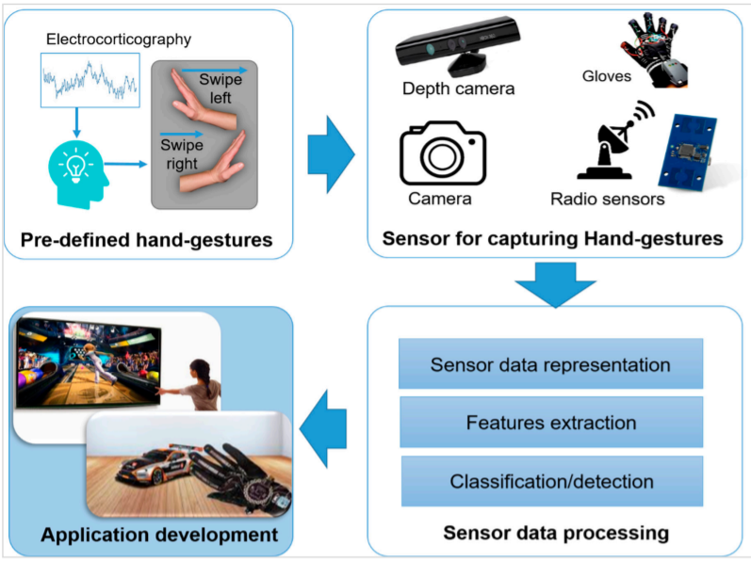
Work plan

Slide 12
Tools
Jupyter
Google deep soli sensor
Camera
Radar
Paper space
Anaconda
Open cv

Slide 13
Modules
Main modules
Tenser flow
keras
CNN
Sparse entropy
Optimiziers
Sklearn modules
Sub modules
3D CNN
POOLING
ACTIVATION LAYER
Accuracy metrics
Sequential
LSTM
Deep CNN
Media Pipe

Slide 14
Approach 1: radar

Slide 15
Deep Soli google Gesture Dataset
The dataset contains multiple preprocessed Range-Doppler Image sequences. Each sequence is saved as a single HDF5 format data file.
File names are defined as [gesture ID][session ID][instance ID].h5.
Range-Doppler Image data of a specific channel can be accessed by dataset name ch[channel ID].
Label can be accessed by dataset name label.
Range-Doppler Image data array has shape of [number of frame] * 1024 (can be reshape back to 2D Range-Doppler Image to 32 * 32)

Slide 16
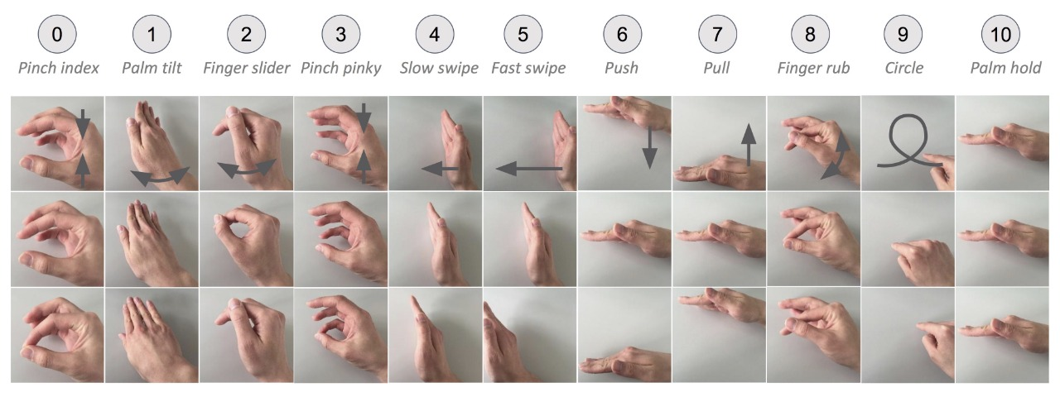
The gestures are listed in the table below.
Each column represents one gesture and there are three important steps for each gestures.
The gesture label is indicated by the number in the circle above.
Sequences with gesture ID 11 are background signals with no presence of hand.

Slide 17
Deep Soli google Gesture Dataset
The Soli sensor is a solid-state millimeter-wave radar.
Classic radar approaches rely on high spatial resolution to discern several rigidly moving targets (e.g., planes).
In contrast, Soli uses a sensing approach that prioritizes high temporal resolution to detect subtle, nonrigid motion.
Soli utilizes a single broad antenna beam to illuminate the entire hand as modulated pulses are transmitted at very high repetition rates (between 1-10 kHz).

Slide 18
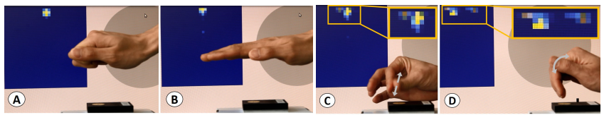
The raw received signal, consisting of a superposition of reflections from scattering centers within the radar’s antenna beam, is then processed into multiple abstract signal representations.
The high temporal resolution enables a combination of fast time and slow time processing to map scattering center reflections into interpretable dimensions.
Range-Doppler images (RDI) attained by mapping received energy into a two-dimensional space of radial distance (or range) and velocity.
Pixel intensity corresponds to reflected energy; horizontal axis is velocity; vertical axis is range.
(A+B) Sensor produces almost identical response for static objects even of distinct shape.
(C+D) In contrast, the sensor resolves even minute motion with high resolution.

Slide 19
Short-range radar data does not directly contain information about shape and hence many existing algorithms are not applicable.
The steps to process the data is:
Signal transformations (e.g., Fourier transform).
Feature Extraction.
Frame-level classification.

Slide 20
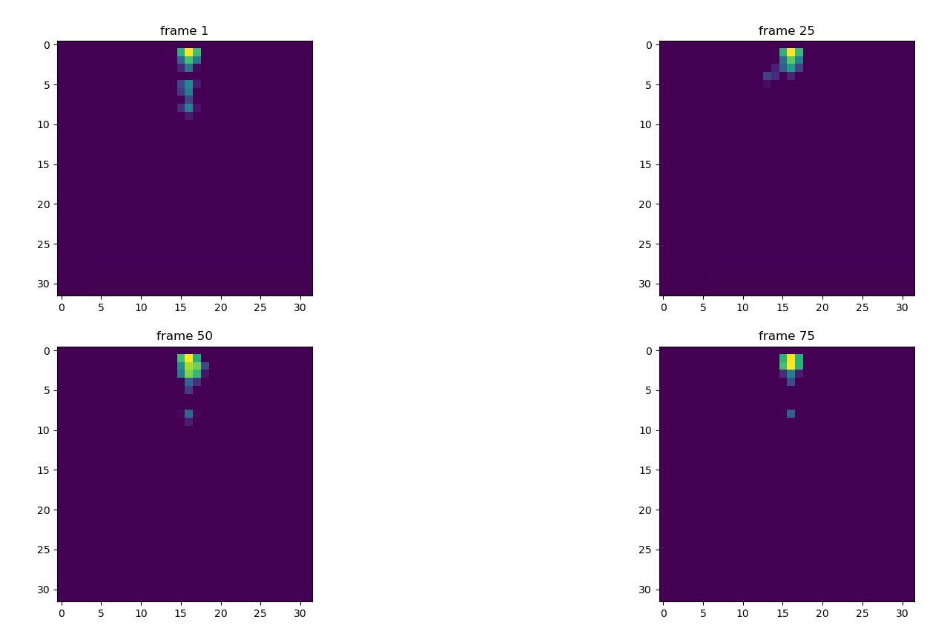
Each data point is a sequence of variable length of 1024 dimensional vector which are reshaped to a [32,32] 2d Doppler map [range, velocity].

Slide 21
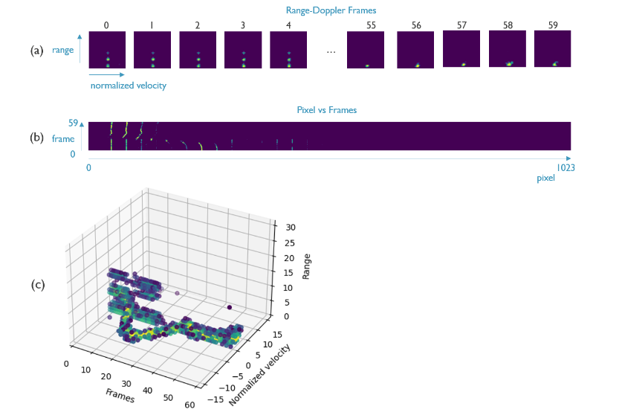

Slide 22
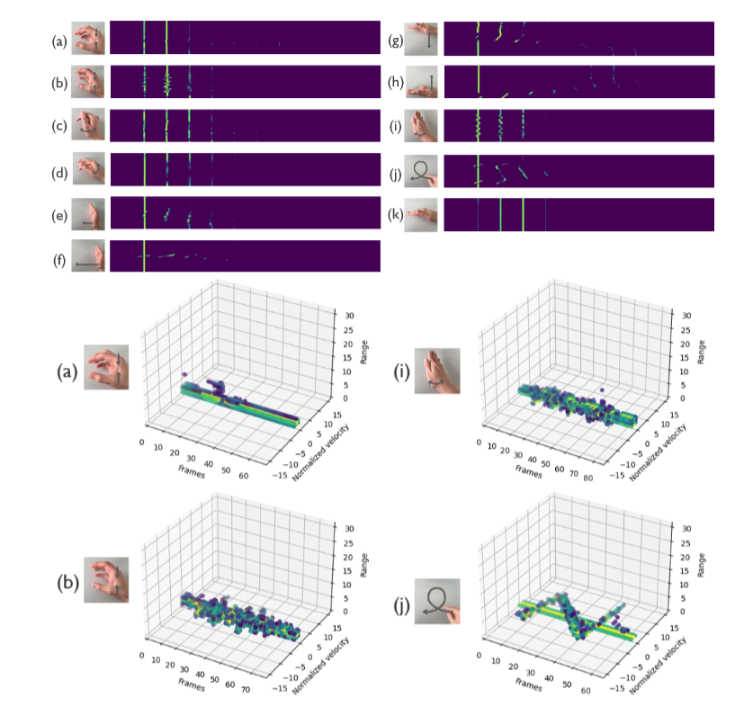
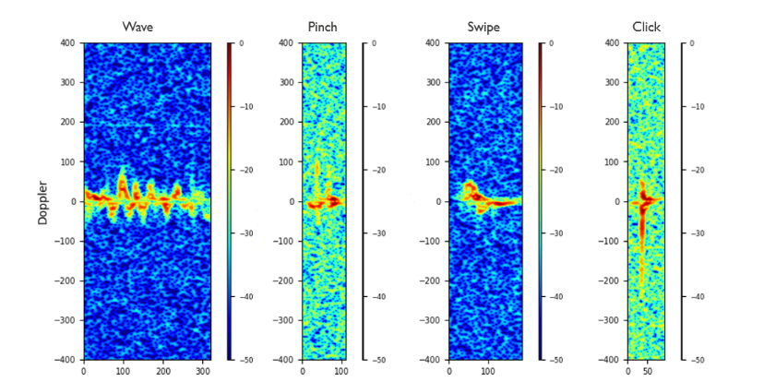
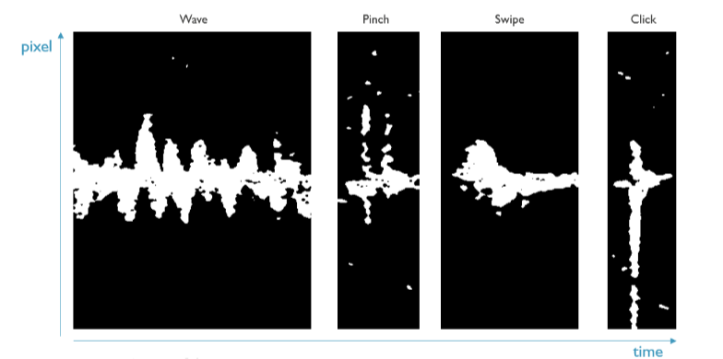

Slide 24
Project Implementation
https://nextjournal.com/a/PzuPgiKRz8DeHsunpsESi?token=TtNyS3bNNvd9mN7pv7MKhX

Slide 25
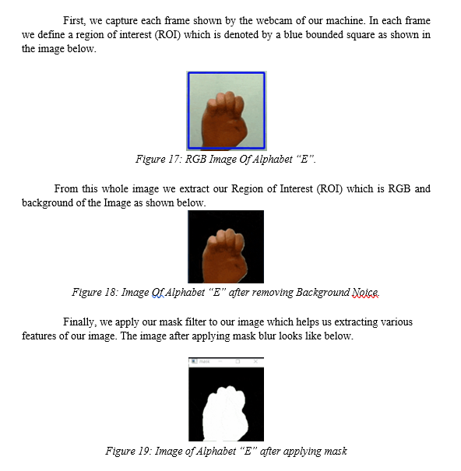
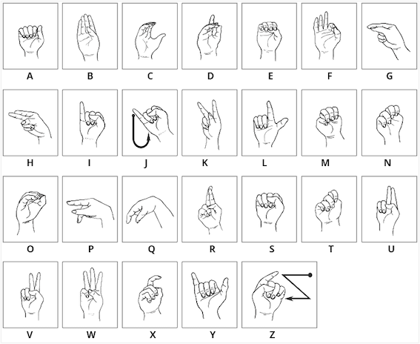
Approach ii : camera
Sign conventions of alphabets in ASL

Slide 26
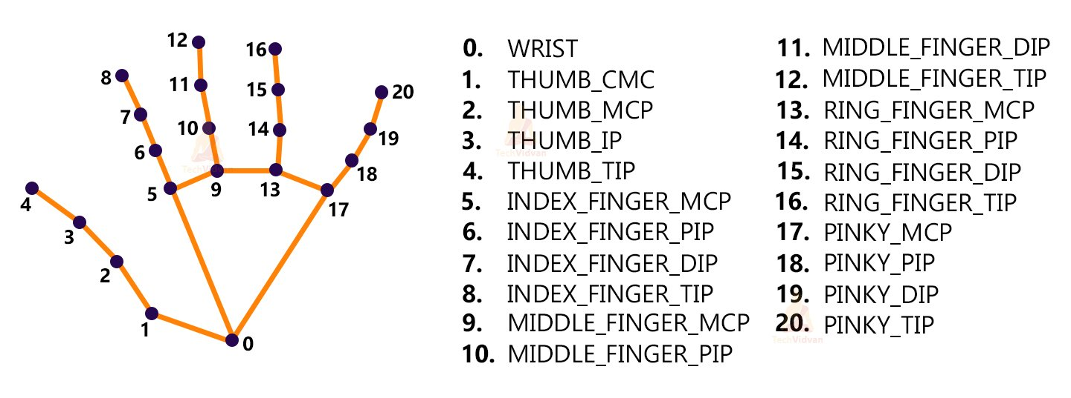
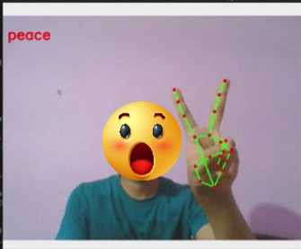
Approach iii : media pipe
Key points detected by MediaPipe

Slide 27
References
Sci-Hub | mmWave Radar-based Hand Gesture Recognition using Range-Angle Image. 2020 IEEE 91st Vehicular Technology Conference (VTC2020-Spring) | 10.1109/vtc2020-spring48590.2020.9128573
https://www.researchgate.net/publication/352328411_Radar-Based_Hand_Gesture_Recognition_Using_Spiking_Neural_Networks
Sadeddine, K., Chelali, Z. F., Djeradi, R., Djeradi, A., & Benabderrahmane, S. (2021). Recognition of user-dependent and independent static hand gestures: Application to sign language. Journal of Visual Communication and Image Representation, 79, 103193. doi:10.1016/j.jvcir.2021.10319
Lan, Shengchang; He, Zonglong; Yao, Kai; Chen, Weichu (2018). [IEEE 2018 IEEE/MTT-S International Microwave Symposium - IMS 2018 - Philadelphia, PA, USA (2018.6.10-2018.6.15)] 2018 IEEE/MTT-S International Microwave Symposium - IMS - Hand Gesture Recognition using a Three-dimensional 24 GHz Radar Array. , (), 138–140. doi:10.1109/MWSYM.2018.8439658
Fanchen Kong, Jingcheng Deng, Zichuan Fan, Gesture recognition system based on ultrasonic FMCW and ConvLSTM model, Measurement, Volume 190, 2022, 110743, ISSN 0263-2241.
H. Kulhandjian, P. Sharma, M. Kulhandjian and C. D'Amours, "Sign Language Gesture Recognition Using Doppler Radar and Deep Learning," 2019 IEEE Globecom Workshops (GC Wkshps), 2019, pp. 1-6, doi: 10.1109/GCWkshps45667.2019.9024607.
https://sci-hub.hkvisa.net/10.23919/EURAD.2017.8249172
Cai, Xiaodong; Ma, Jingyi; Liu, Wei; Han, Hemin; Ma, Lili (2019). [ACM Press the 2019 ACM International Joint Conference on Pervasive and Ubiquitous Computing and the 2019 ACM International Symposium - London, United Kingdom (2019.09.09-2019.09.13)] Proceedings of the 2019 ACM International Joint Conference on Pervasive and Ubiquitous Computing and Proceedings of the 2019 ACM International Symposium on Wearable Computers - UbiComp/ISWC '19 - Efficient convolutional neural network for FMCW radar based hand gesture recognition. , (), 17–20. doi:10.1145/3341162.3343768

Slide 28
References
E.D.G. Sanjeewa, K.K.L. Herath, B.G.D.A. Madhusanka, H.D.N.S. Priyankara, H.M.K.K.M.B. Herath, Chapter 14 - Understanding the hand gesture command to visual attention model for mobile robot navigation: service robots in domestic environment, Editor(s): Mamta Mittal, Rajiv Ratn Shah, Sudipta Roy, In Cognitive Data Science in Sustainable Computing, Cognitive Computing for Human-Robot Interaction, Academic Press, 2021, Pages 287-310, ISBN 9780323857697
A. Helen Victoria;G. Maragatham; (2021). Gesture recognition of radar micro doppler signatures using separable convolutional neural networks . Materials Today: Proceedings, (), –. doi:10.1016/j.matpr.2021.05.658
Yang, Y., Li, J., Li, B. et al. MDHandNet: a lightweight deep neural network for hand gesture/sign language recognition based on micro-doppler images. World Wide Web (2022). https://doi.org/10.1007/s11280-021-00985-1
Ing Jyh Tsang;Federico Corradi;Manolis Sifalakis;Werner Van Leekwijck;Steven Latré; (2021). Radar-Based Hand Gesture Recognition Using Spiking Neural Networks . Electronics, (), –. doi:10.3390/electronics10121405
S. Hazra and A. Santra, "Radar Gesture Recognition System in Presence of Interference using Self-Attention Neural Network," 2019 18th IEEE International Conference On Machine Learning And Applications (ICMLA), 2019, pp. 1409-1414, doi: 10.1109/ICMLA.2019.00230.
https://www.researchgate.net/publication/354463749_Dynamic_Hand_Gesture_Recognition_Using_3D-CNN_and_LSTM_Networks/citations.
Wang, Jixin; Liu, Tingting; Wang, Xuan (2020). Human hand gesture recognition with convolutional neural networks for K-12 double-teachers instruction mode classroom. Infrared Physics & Technology, 1110, 103464-. doi:10.1016/j.infrared.2020.103464

Slide 29
Thanks!

